Slide 1


Slide 2
Scope
Milestone #1 | Importance of Big Data Security Big Data Security Technologies
Milestone #2 | Big Data Security Risk
Milestone #3 | Big Data Security Use Cases
Milestone #4 | Big Data Security Issues Regulations and Policies
Milestone #5 | Implementation Part 1
Milestone #6 | Implementation Part 2
Milestone #7 | Implementation Part 3

Slide 3
Agenda
Discuss the Fourth Milestone
Big Data Security Issues
Regulations and Policies
Conclusion

Slide 4
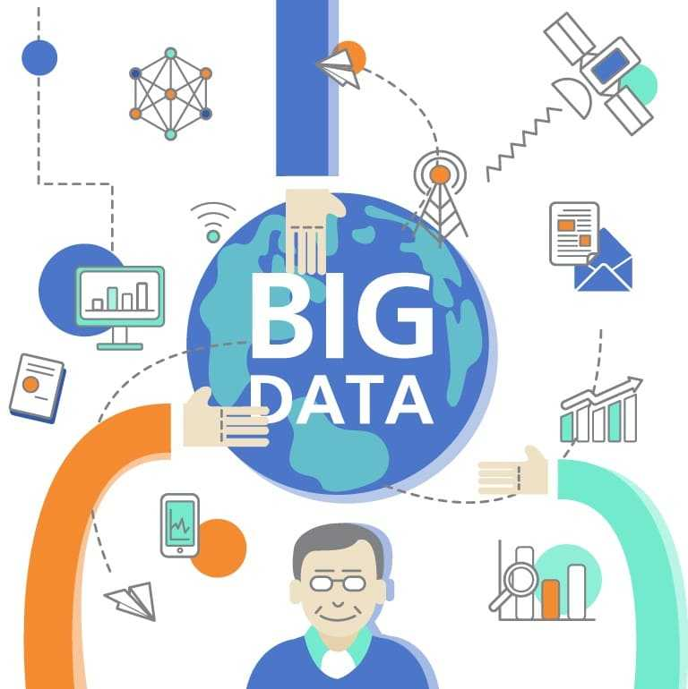
Topic: Access control
Merging large numbers of access control policies
Restrict access to data from the companies
Unencrypted sensitive data strode at cloud
Encrypted: All or-nothing retrieval policy
Need for granular access control
https://estidevelopers.com/2020/08/12/what-big-data-can-teach-us-about-consumers-experience-it-recruitment-in-the-netherlands/
Notes:
Note: In most cases, sensitive data is stored in the cloud unencrypted. The biggest issue with encrypting data is the all-or-nothing retrieval policy, which prevents users from doing fine-grained actions like sharing information or conducting searches. The less sensitive data that is valuable for analytics must be exchanged in a secure and agreed-upon manner utilizing a cryptographically secure communication architecture. Granular access is not possible with big data technology. Copying essential data to a separate big data warehouse is one solution. For medical research, for example, only the medical information is copied, leaving outpatient names and addresses.
However, encryption entails a significant amount of overhead. Rather than processing plain text, the majority of the operations will be carried out in cryptographic form. As a result, the cryptographic technique to processing contributed to the security layer.
In most circumstances, Big Data necessitates the merging of data from many sources. These data sets can be linked to "fixed policies," which must be followed even when the data set is combined with other data sets. As a result, policies must be integrated, and conflicts can be addressed using a policy integration system that is either fully automated or semi-automated.
Granular access is not practicable with information technologies. Copying essential data to a separate big data storage is one solution. For medical research, for example, only the medical information is copied, wiping out patient names and addresses.
Its impact on (volume-variety-veracity)
Singh, D., Nath, I., &amp; Singh, P. K. (2020). Security and Privacy Challenges in Big Data. Security, Privacy, and Forensics Issues in Big Data, 97–124. https://doi.org/10.4018/978-1-5225-9742-1.ch004
Maayan, G. D. (2020, February 14). Big Data Security: Challenges and Solutions. DATAVERSITY. https://www.dataversity.net/big-data-security-challenges-and-solutions/
Inukollu, V. N., Arsi, S., & Rao Ravuri, S. (2014). Security Issues Associated with Big Data in Cloud Computing. International Journal of Network Security & Its Applications, 6(3), 45–56. https://doi.org/10.5121/ijnsa.2014.6304

Slide 5
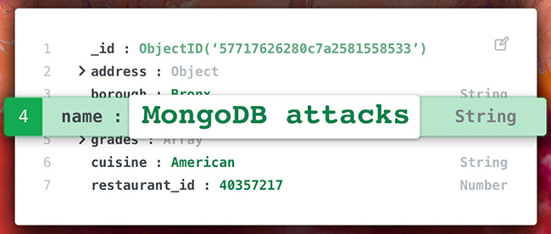
Topic: Non-relational data stores
Flexible but not secure
Authentication issues
Not compatible with external encryption
Huge volume of unstructured data sets
93.4 million Mexican voters
1.1 million BeautifulPeople.com
58 million customers :Modern Business Solutions
https://www.helpnetsecurity.com/2020/07/08/mongodb-is-subject-to-continual-attacks-when-exposed-to-the-internet/
Notes:
Note: NoSQL has not been designed with security as a main concern, so developers or security teams must add a security layer to their organizations’.
Anyone can simply implement these databases because they are open source. That's great for enticing customers and getting developers things up and running when they're on a tight schedule, but it also means MongoDB and other NoSQL database makers have no control over how users set up and secure their databases. some problematic defaults, like not requiring password authentication and granting users overly broad privileges
Its impact on (variety, veracity, validity, vulnerability,)
GETTY IMAGES, A. W. (n.d.). If You Want to Stop Big Data Breaches, Start With Databases. Wired. Retrieved June 21, 2021, from https://www.wired.com/2017/03/want-stop-big-data-breaches-start-databases/
VICKERY, C. (2015, December 14). 13 Million MacKeeper Users Exposed – Krebs on Security. Https://Krebsonsecurity.com/. https://krebsonsecurity.com/2015/12/13-million-mackeeper-users-exposed/

Slide 6
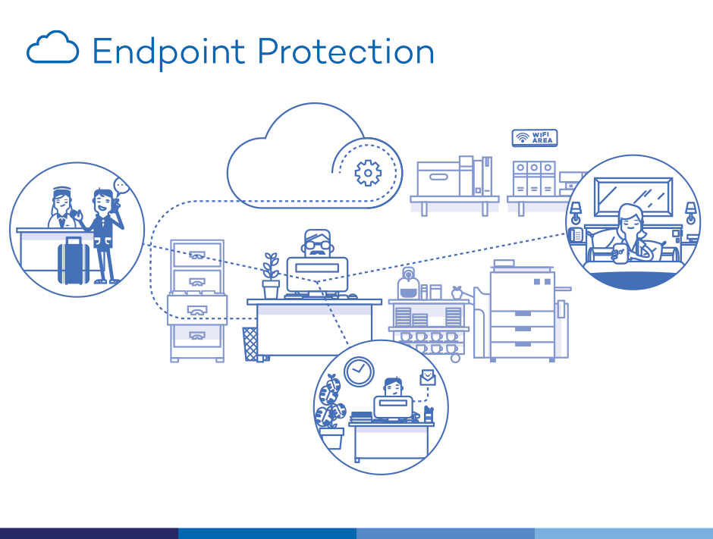
Topic:Endpoints
Input validation
Data filtration
Manipulation data by cybercrime
Privacy for Endpoint
Variety of Sources
End points are like double-edged swords
May attacked by cyber criminals due to lack of training and negligence
may engage in cyber sabotage as internal threats (extortion or revenge)
https://www.synopc.com/promotion
Notes:
Input validation is a critical difficulty in the data collecting process when we collect data from millions of hardware devices and software applications in a business network.
Because of the massive volume of data collected in Big Data, it's impossible to validate and filter data on the fly.
Cybercriminals can tamper with data on endpoint devices and send the erroneous information to data lakes.
Its impact on (volume, value, variety, veracity, validity, vulnerability,)
Ariyaluran Habeeb, R. A. (2014, April). A Highlight of Security Challenges in Big Data.
Big Data Security - Implementation, Use cases and Issues. (2020, April 16). TechVidvan. https://techvidvan.com/tutorials/big-data-security/

Slide 7

Topic:Real-time security
High volume of alerts
Many false positive
Need to process data fast
Authentication and authorization of the users
https://www.n-able.com/blog/real-time-monitoring
Notes:
Because of the large number of alerts issued by security equipment, real-time security monitoring is difficult. given the volume and velocity of big data streams.
Receiving large volumes of False Positives makes it difficult to filter out true alerts.
The high volume of unverified and unrated data limits the ability to detect attacks and threats in real time, and this requires high speed and accuracy in tracking and tracking threats.
Its impact (volume, Velocity, variety, veracity, validity, vulnerability)
Cloud Security Alliance -All Rights Reserved. (2013). Expanded Top Ten Big Data Security and Privacy Challenges. https://downloads.cloudsecurityalliance.org/initiatives/bdwg/Expanded_Top_Ten_Big_Data_Security_and_Privacy_Challenges.pdf
Smallcombe, M. (2020, June 30). 11 Big Data Security Concerns. Xplenty. https://www.xplenty.com/blog/big-data-security-concerns/#mining
Moreno, J., Serrano, M., & Fernández-Medina, E. (2016). Main Issues in Big Data Security. Future Internet, 8(3), 44. https://doi.org/10.3390/fi8030044

Slide 8
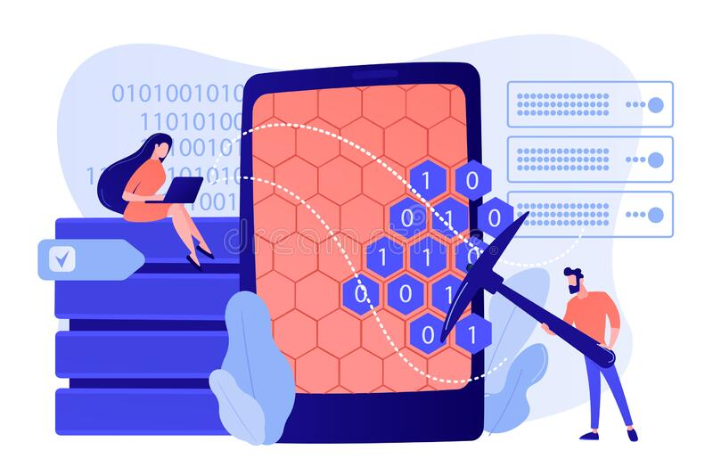
Topic: Data mining
Lack of privacy protocols
Insufficient data anonymization
Unstructured and lack of access control
malicious insider &unauthorized partner
https://www.dreamstime.com/data-mining
Notes:
Inside analysts, as well as outside contractors and business partners, have ongoing access to user data acquired by huge corporations.
2-Anonymizing data for analytics is insufficient to ensure user privacy; for example, AOL issued an anonymized search record for academic purposes, but users could be recognized based on their queries.
3-Demographic information about age and geography can help reveal valuable patterns, but during data mining, for example, can access credit card information, social security numbers, or other confidential information.
4-This data set can be abused by an untrustworthy partner or a malevolent insider to extract client information.
Its impact (volume, variety, veracity, validity, vulnerability)
Maayan, G. D. (2020, February 14). Big Data Security: Challenges and Solutions. DATAVERSITY. https://www.dataversity.net/big-data-security-challenges-and-solutions/
LarsonReever. (2019, September 5). Big Data Security — Issues, Challenges, Tech & Concerns. Medium. https://medium.com/wp-hacked-help/big-data-security-issues-challenges-tech-concerns-f1a800995148

Slide 9

Topic: storage
Unauthorized access to stored data
Storage management for large volume of data
Auto-tiering threat
Confidentiality and Integrity
Availability and Consistency
Collusion Attacks
Disputes
https://guidance-consulting.com/data-storage-options/
Notes:
1: While resting on cloud or on-premise servers, data in storage can be stolen or held hostage.
Unauthorized access to data while transferring it from one source to another may result in modified data being transferred to end users.
Manually moving data between layers allows the developer complete control over what data is transported and when. However, as the amount of data sets rises rapidly, auto-tiering for large data storage management has become necessary.
Its impact (volume, veracity, validity, volatility, vulnerability)
Ariyaluran Habeeb, R. A. (2014, April). A Highlight of Security Challenges in Big Data. Https://Www.researchgate.net/. https://www.researchgate.net/publication/330752767_A_Highlight_of_Security_Challenges_in_Big_Data

Slide 10
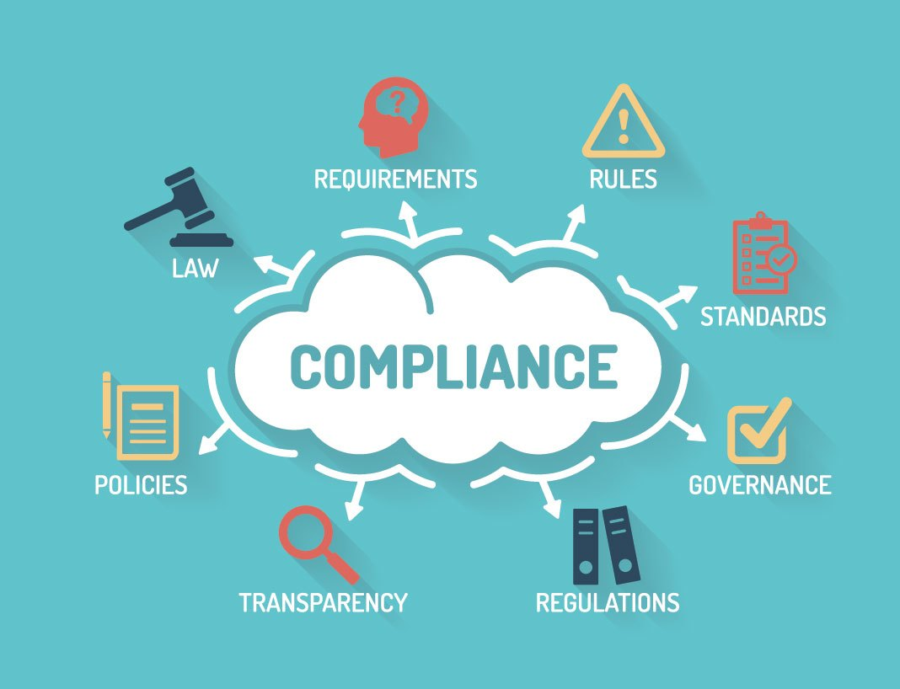
Topic: Regulation and Policy
Regulation
HIPAA: Health Insurance Portability and Accountability Act
HITECH:Health Information Technology for Economic & Clinical Health
GDPR :General Data Protection Regulation(EU)
CCPA (California Consumer Privacy Act)
PIPEDA: Personal Information Protection and Electronic Documents Act
PIPA(Alberta&BC)
FISMA: The Federal Information Security Management Act
https://www.whoa.com/what-businesses-need-to-know-about-pci-compliance-and-the-cloud/
Notes:
Policies are rules set by organizations to achieve their goals and objectives. These policies are developed by individuals, groups, companies and even governments to implement their programs. Regulations are rules that are made to make people comply and behave in a certain manner. A regulation has the effect of a law and is considered as a restriction that is imposed by authorities, to make people follow the desired code of conduct.
Businesses must appoint a Data Protection Officer (DPO), who is responsible for overseeing aspects like GDPR compliance and data security policy. If a breach occurs, the DPO must notify affected persons and regulators within 72 hours of the occurrence. Noncompliance carries severe consequences.
B, N. (2016, July 19). Difference between Policy And Regulations. Www.linkedin.com. https://www.linkedin.com/pulse/difference-between-policy-regulations-navya-b
Cisternelli, E. (2020, December 28). 7 Cybersecurity Frameworks To Reduce Cyber Risk. BitSight. https://www.bitsight.com/blog/7-cybersecurity-frameworks-to-reduce-cyber-risk
CAVEY, S. (2021, April 22). What is the CDPA? Virginia’s Consumer Data Protection Act. Ground Labs. https://www.groundlabs.com/blog/what-is-the-cdpa/
TERRA, J. (2018, April 26). GDPR and What It Means for Big Data. Simplilearn.com. https://www.simplilearn.com/gdpr-and-what-it-means-for-big-data-article
Ostendio. (2017, October 30). Why HIPAA Remains Important to Healthcare Data Protection. Www.ostendio.com. https://www.ostendio.com/blog/why-hipaa-remains-important-to-healthcare-data-protection

Slide 11
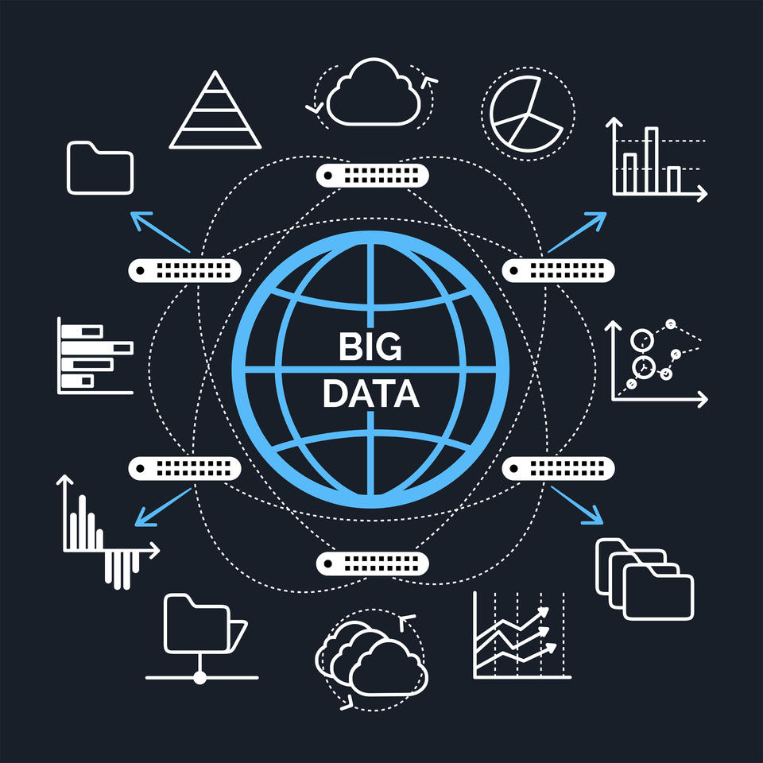
Topic: Regulation and Policy
NBDIF: NIST Big Data Interoperability Framework
(NIST SP) 1500-4r2Security and Privacy -Volume 4
Policies
NIST 800-171
NIST 800-53
FIPS 199
FIPS 200
1- Conceptual Security and Privacy Taxonomy
confidentiality of personal data
integrity and validation of personal data.
availability personal data, Public policy, social, and cross-organizational
protection the specific Big Data and privacy & data protection requirements
https://www.nist.gov/blogs/blogrige/challenge-information-analytics
Notes:
The NIST Cybersecurity Framework, which has become the gold standard of cybersecurity in the US and for many global entities. Security & Privacy Topics:
Database and storage security: Data anonymization and sanitation, Management and querying of encrypted data, Information responsibility and usage control, Database activity monitoring, Software and application security: Software security engineering, Web application security, Social network security and privacy, Domain-specific security and privacy architectures, Software reverse engineering
Human and social aspects of security and privacy: Economics of security and privacy, Social aspects of security and privacy, Privacy protections, Usability in security and privacy
Big data at NIST The NBDIF is divided into nine volumes, with volume 4 focusing on security and privacy. The NIST Big Data Security & Privacy Subgroup has developed two taxonomies for Big Data security and privacy: a conceptual security and privacy taxonomy and an operational security and privacy taxonomy.
The NIST Big Data Security & Privacy Subgroup has developed two taxonomies for Big Data security and privacy: a conceptual security and privacy taxonomy and an operational security and privacy taxonomy.
The first three issues concern classical security principles such as confidentiality, integrity, and availability (CIA). The fourth is focused on privacy and data protection, and it includes social aspects of trade, intellectual property, trans-border data flows, and legal considerations, among other things.
NIST Big Data Interoperability Framework : (2019). NIST Big Data Interoperability Framework. https://doi.org/10.6028/nist.sp.1500-2r2
Big data analytics privacy data protection. (2020, January 17). Atos. https://atos.net/
Myers, C. (2018, July 10). Big Data, Privacy, and the Law: How Legal Regulations May Affect PR Research | Institute for Public Relations. Institute for Public Relations. https://instituteforpr.org/big-data-privacy-and-the-law-how-legal-regulations-may-affect-pr-research/
Naden, C. (2020, November 5). Getting big on data. ISO. https://www.iso.org/news/ref2578.html
Bitchkei, S. (2019, May 14). Data Security Regulations Overview by Industry: Finance - Systèmes de Sécurité Hitachi. Https://Hitachi-Systems-Security.com/. https://hitachi-systems-security.com/data-security-regulations-overview-by-industry-finance/
Office of the Privacy Commissioner of Canada. (2019). Questions and Answers regarding the application of PIPEDA, Alberta and British Columbia’s Personal Information Protection Acts - Office of the Privacy Commissioner of Canada. Priv.gc.ca. https://www.priv.gc.ca/en/privacy-topics/privacy-laws-in-canada/the-personal-information-protection-and-electronic-documents-act-pipeda/r_o_p/02_05_d_26/

Slide 12

Topic: Regulation and Policy
2- operational security and privacy taxonomy
Device and Application Registration
Identity and Access Management
Data Governance: administering, or formalizing, discipline (behavior patterns)
Infrastructure Management;
Risk and Accountability
https://citysecuritymagazine.com/security-technology/big-data-analytics-in-security/
Notes:
The 'Operational Security and Privacy Taxonomy' includes checklists for implementing security and privacy techniques in Big Data systems. The Operational Taxonomy for Big Data tackles the following security and privacy issues.,
Use Cases
Network Protection, Systems Health & Management (AWS metrics, billing, performance), Education, Cargo Shipping, Aviation (safety), UAV, UGV regulation, Regulated Government Privacy (FERPA, HIPAA, COPPA, GDPR, PCI etc.),Healthcare Consent Models ,HL7 FHIR Security and Privacy
Big data analytics privacy data protection. (2020, January 17). Atos. https://atos.net/
NIST Big Data Interoperability Framework : (2019). NIST Big Data Interoperability Framework. https://doi.org/10.6028/nist.sp.1500-2r2

Slide 13

Conclusion
Big data is one of the modern phenomena in the world that has opened a new window on the IT industry, but in addition to these benefits, there is a need to strengthen the security and protection infrastructure for big data and a list of issues related to big data security. It is still growing. There are many privacy concerns and government regulations for big data platforms. However, organizations and private users do not always know what their information is about and where the data is stored. Therefore, in recent years, we have made many efforts to grow and develop security infrastructure, as well as stricter rules and regulations for big data security.

